Slide 1
Sriam, because of the size of the infographics, I couldn’t fit several into the small PowerPoint pane, but when I snipped the images, I tried to give you an idea of their essence.

Slide 2
BlackRock: static
The biggest problem? Text-heavy. Well-done, but not striking. The white lettering should be brighter and in greater contrast with the background colors. Is the use of purple necessary? The purple background doesn’t contrast as well with the white lettering as the other colors.
https://www.blackrock.com/investing/insights/retirement/retirement-considerations

Slide 3
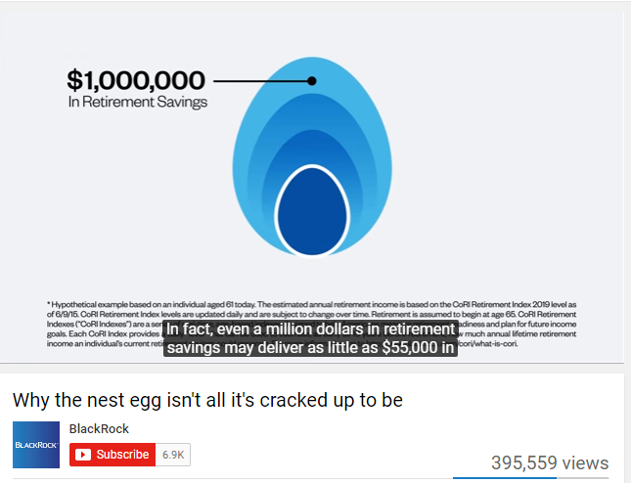
BlackRock: video
Excellently done. Treats the subject in a fluid and easy to understand manner.
https://www.youtube.com/watch?v=gvLRX7XWunM

Slide 4
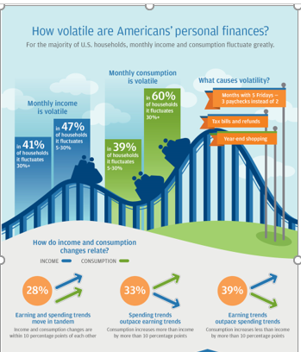
JPMorganChase: static
Very effective. The use of rollercoaster imagery is smart—and the blue-sky background is an ironic contrast. Good use of color theory—the orange is very striking. Plus the graphics tell the story.
https://www.jpmorganchase.com/corporate/institute/infographic-weathering-volatility.htm

Slide 5
JPMorgan: video
Excellently done. Treats the subject in a fluid and easy to understand manner.
https://www.youtube.com/watch?v=gvLRX7XWunM

Slide 6
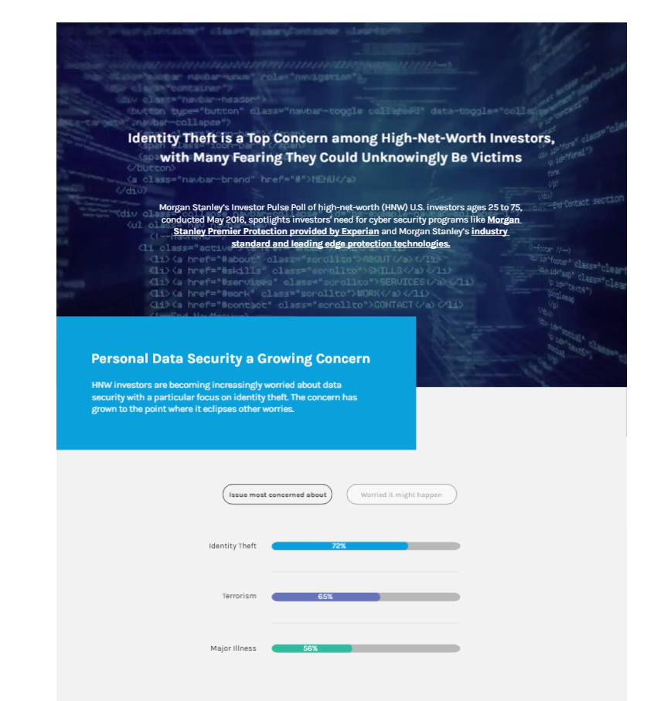
Morgan Stanley: interactive video
Excellent. Although only a portion of the infographic can be shown here, it’s interactive and contains video. Visually it’s striking and demonstrates Morgan’s technological and intellectual sophistication.
https://www.morganstanley.com/ideas/identity-theft-protection

Slide 7
Morgan Stanley: YouTube video
An excellent approach to a difficult subject.

Slide 8
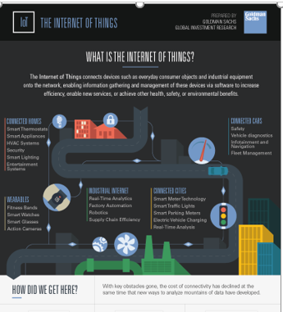
Goldman Sachs: static
Very well done. The use of a black background is interesting—it provides high contrast with the other colors effortlessly. The way the images progress from one idea to another is also very smart through the “pipeline.”
http://www.goldmansachs.com/our-thinking/pages/internet-of-things/infographic-800x3188.png

Slide 10
PIMCO: static (Facebook)
Not bad. The subdued gray background is nice, but note how the green lettering doesn't stand out, instead seeming to bleed into the background. A higher-contrast color should have been used. But the sine curves are effective. In the title, good use of the white lettering against the dark blue background—see how they message stands out?
https://www.facebook.com/PIMCO/photos/a.10150783308786059.391165.54892506058/10154134229651059/?type=3&theater

Slide 11
American Funds: static (on Facebook)
Very good! Three very contrasting colors. The icons communicate their purpose very well. But it would be better if the white lettering was brighter and provided sharper contrast with the background colors.
https://www.facebook.com/americanfunds/

Slide 12
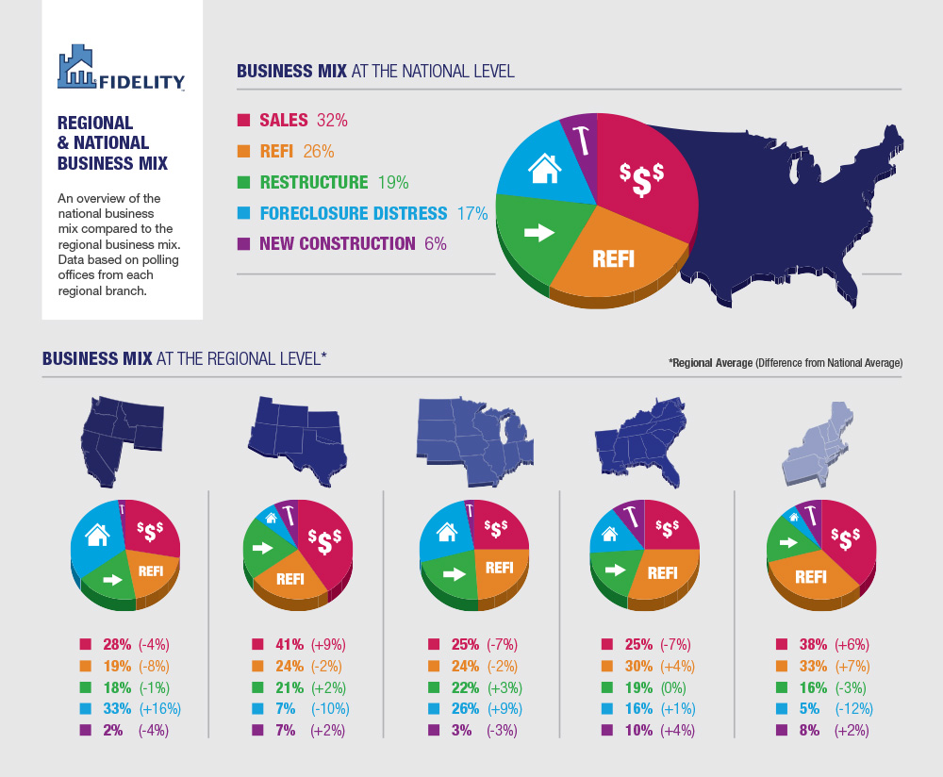
Fidelity: static
Brilliant! Outstanding use of high-contrast colors. See how effective the subdued gray background is? The graphics are clear and sharp, and the graphic delivers its message very effectively.
http://images.stationfour.com/portfolio/detail/FNF-Infographic/fnf-presentation-2.jpg

